Slide 1
Child Advocacy Centers
West Virginia Child Advocacy Network
Notes:
Grace

Slide 2


Child Victimization in WV FY 2018-19
2,721
1,820

Slide 3
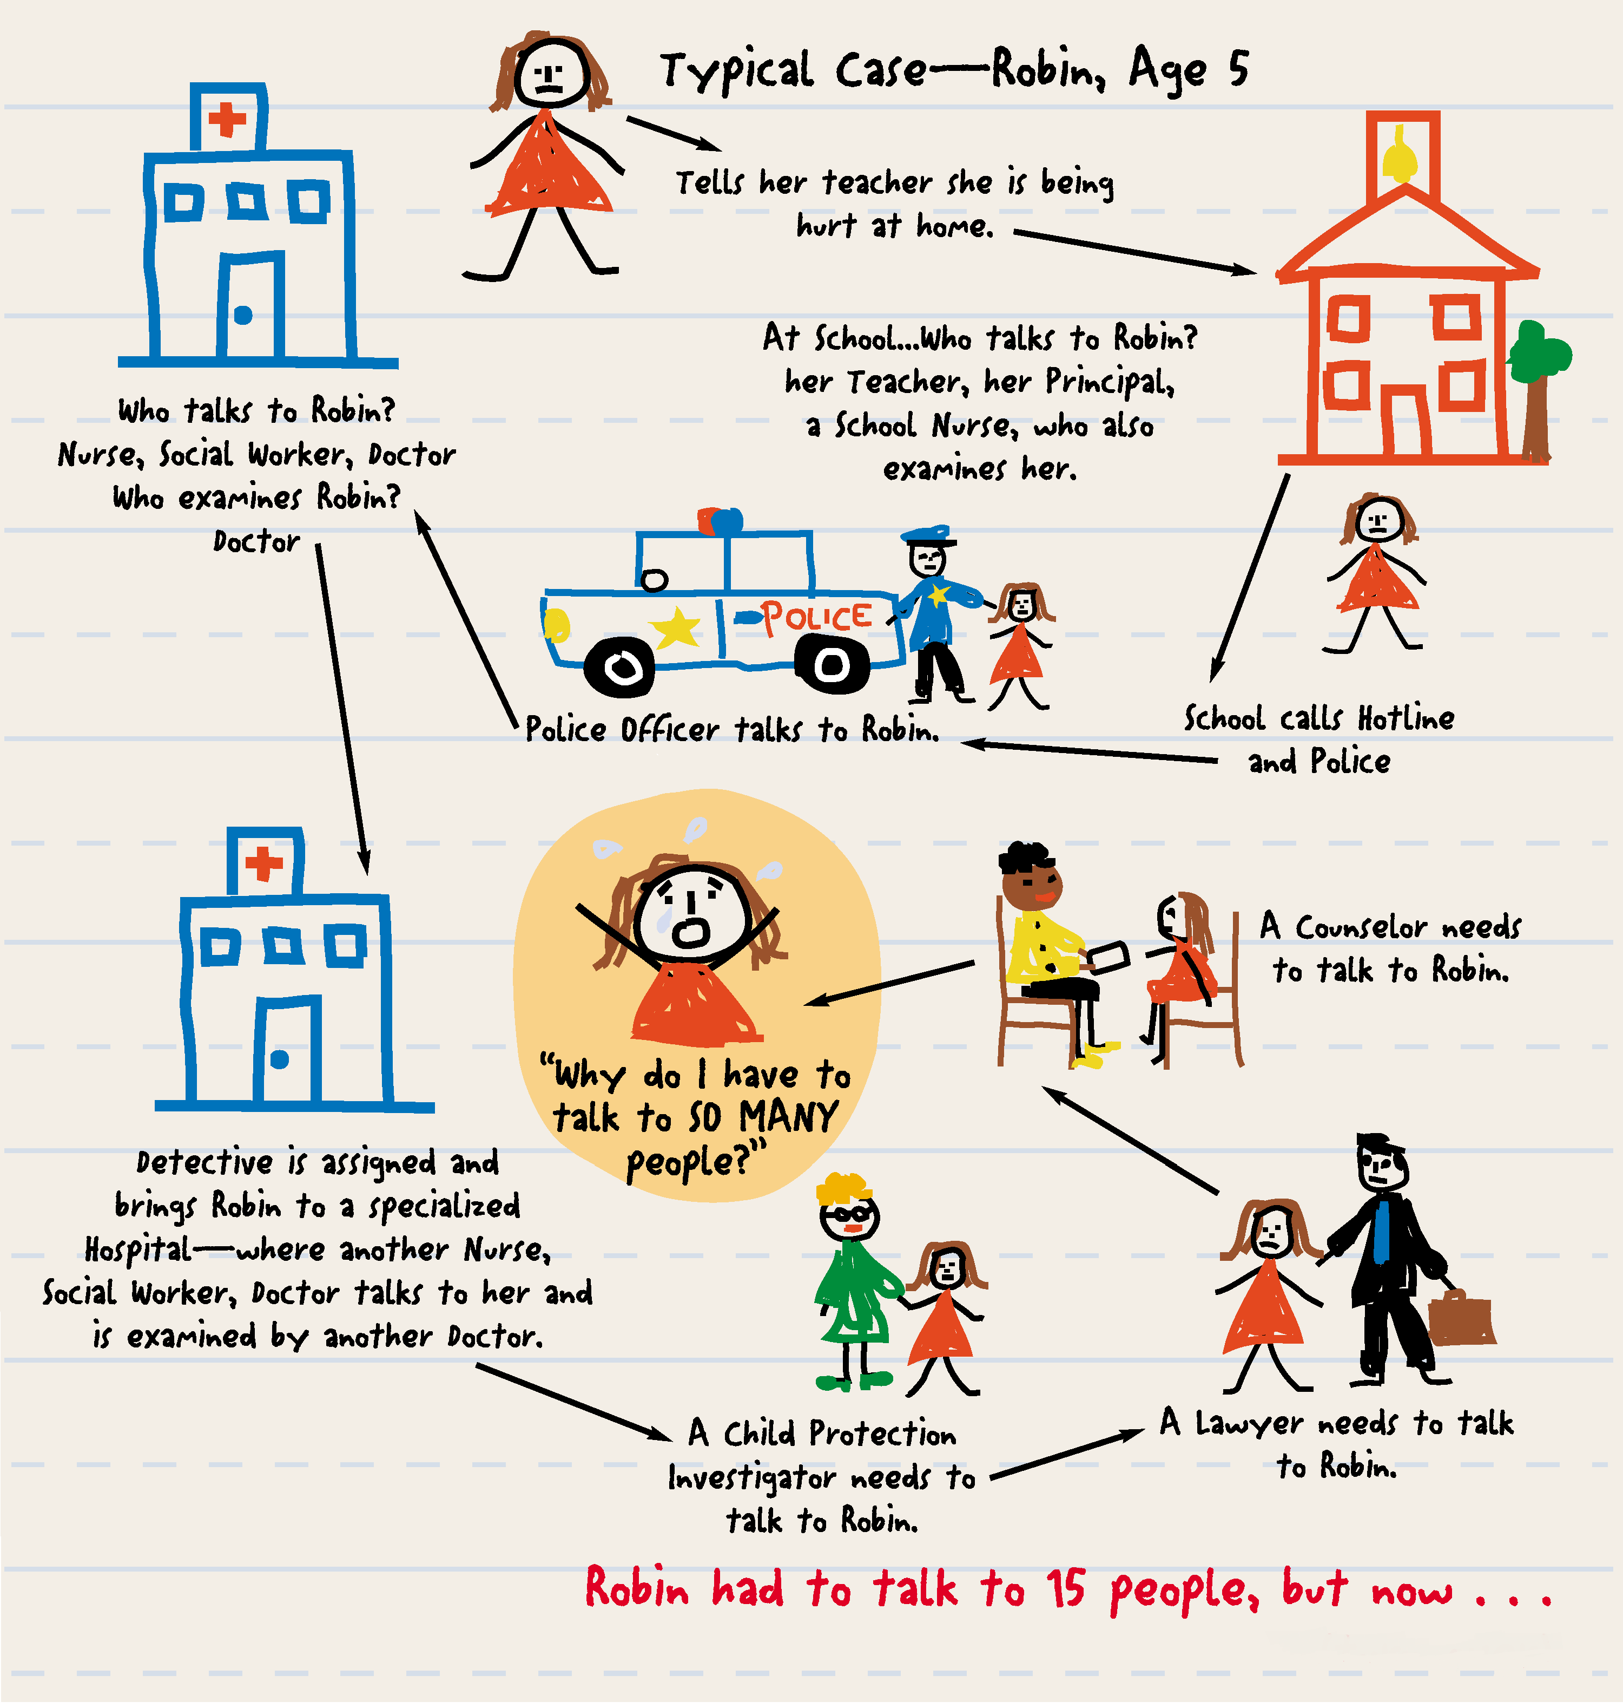
Notes:
Non-CPS ref. ‘Screened Out’. Example here of outside the home abuse.

Slide 4
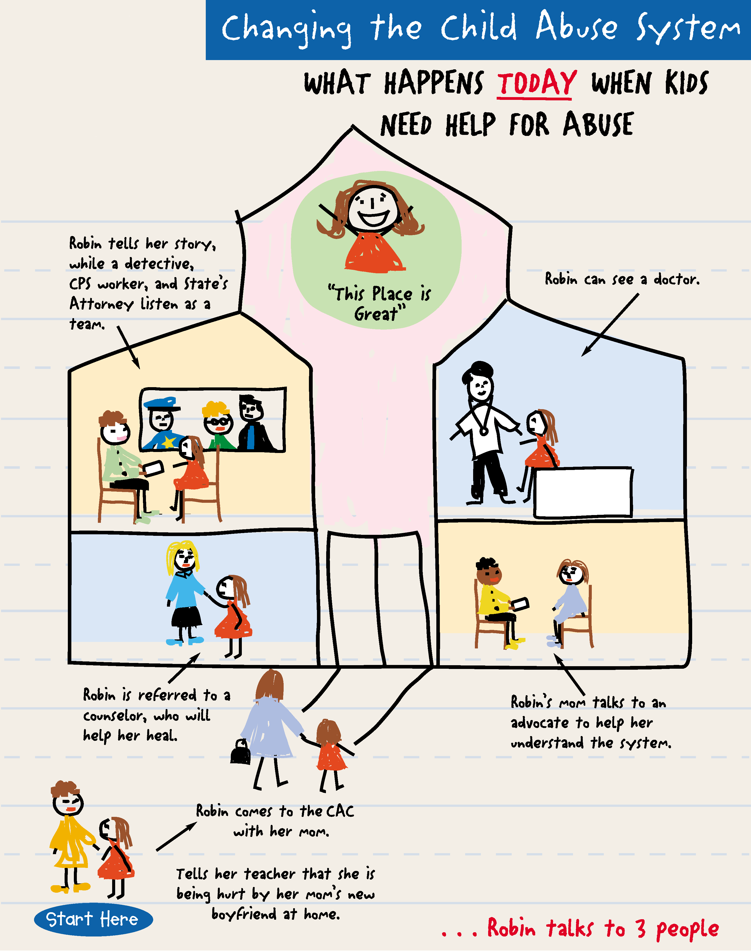

Slide 5
Child Protection
Prosecution
Law Enforcement
Medical
Mental Health
Victim Advocacy
The Model
CAC
Child

Slide 6

GRASSROOTS

Slide 7

How it all began…
1985 – first CAC established in Huntsville, Alabama
National Children’s Advocacy Center
Notes:
Caitlin

Slide 8
How it all began…
1987 – National Network of Children’s Advocacy Centers established out of National Children’s Advocacy Center
  Rebranded as National Children’s Alliance, moved to Washington, DC
1990 – Victims of Child Abuse Act authorized
1992 – First federal CAC funding appropriated

Slide 9
Local CAC/MDT
(National CAC)
National Children’s Alliance
(Washington, DC)
Regional Children’s Advocacy Centers (Housed at 4 CACs around US)
Chapters (of NCA)
Legislation/Dist. Funds/Development
Training/Technical Assistance
Accreditation/Standards/Administer Grants
Training & Technical Assistance

Slide 10
National Accreditation
Multidisciplinary Team
Cultural Competency
Forensic Interviews
Medical Evaluations
Mental Health
Victim Advocacy
Organizational Capacity
Case Review
Case Tracking
Child-Friendly Facility

Slide 11
How it all began in West Virginia…
1999 – Summers County CAC first Associate Member of National Children’s Alliance
2001 – group began to meet in Southeast WV
2003 – group expanded statewide to form West Virginia Child Advocacy Network
2006 (Fall) – first two CACs accredited by National Children’s Alliance (Lewisburg and Fayetteville)

Slide 12
How it all began in West Virginia…
2006 (Winter) – WVCAN incorporated, gained membership with National Children’s Alliance
2008 – CACs obtained first state funding, first WVCAN staff hired
2007 – CACs defined in state code

Slide 13
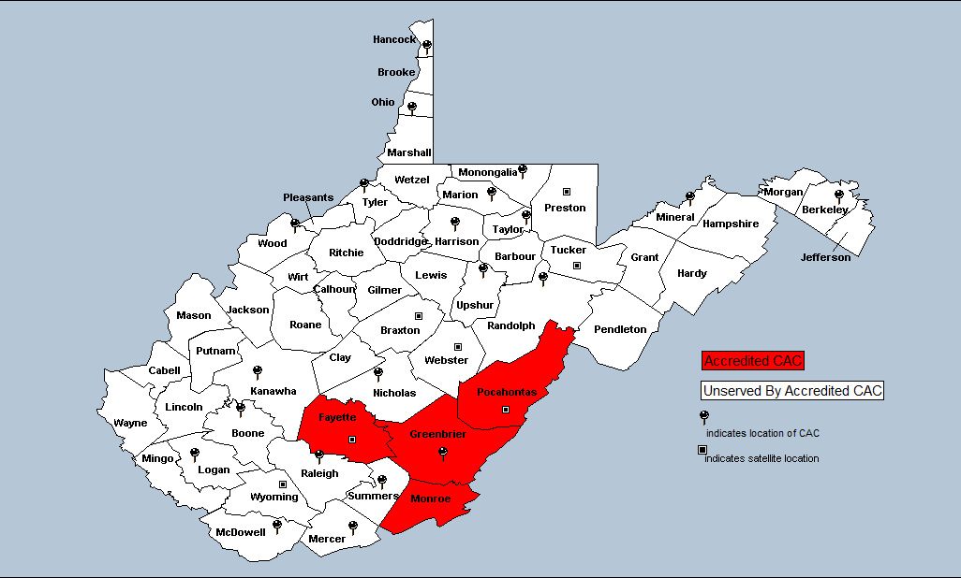
2006 (Prior to State Funding)
2 accredited CACs; 4 counties

Slide 14
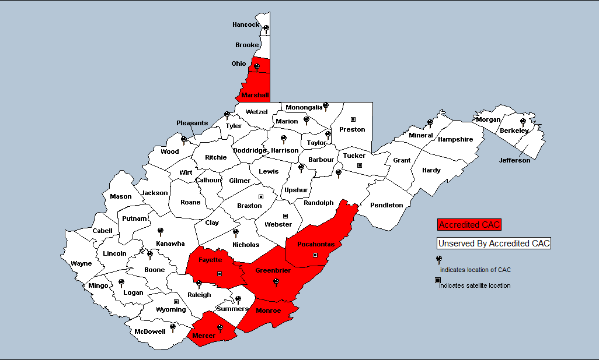
2007
4 accredited CACs; 7 counties

Slide 15
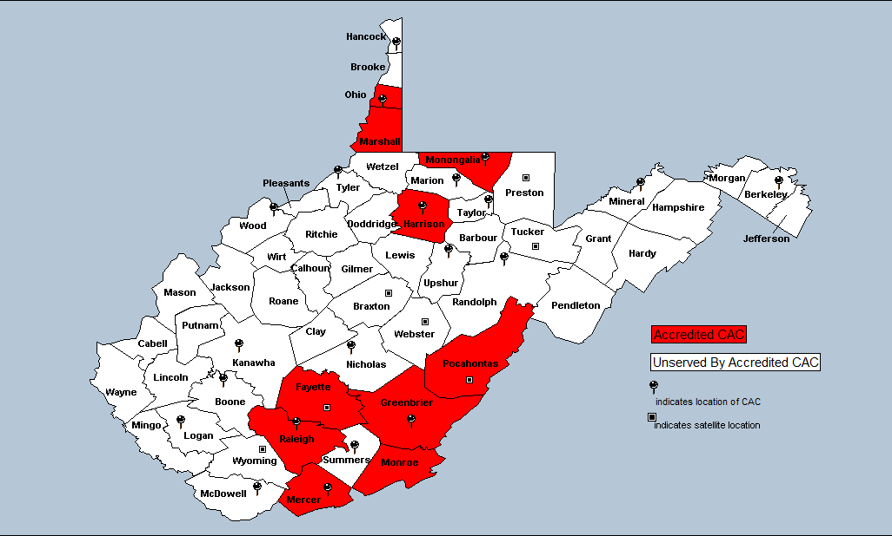
2009
6 accredited CACs; 10 counties

Slide 16
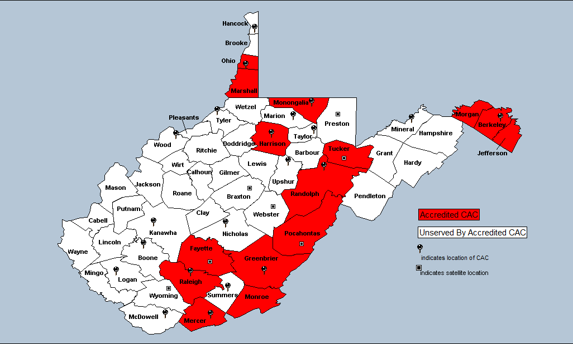
2010
8 accredited CACs; 15 counties

Slide 17
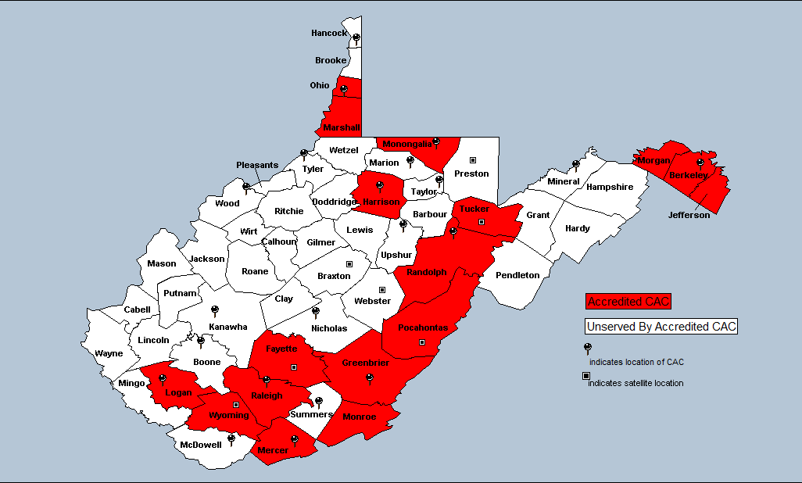
2011
9 accredited CACs; 17 counties

Slide 18
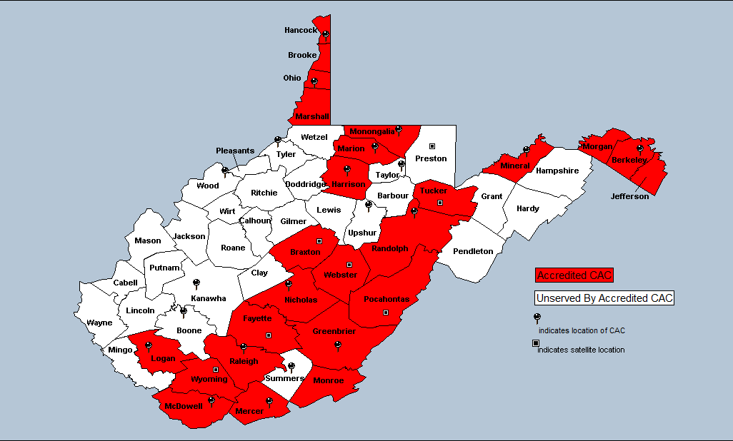
2012
14 accredited CACs; 25 counties

Slide 19
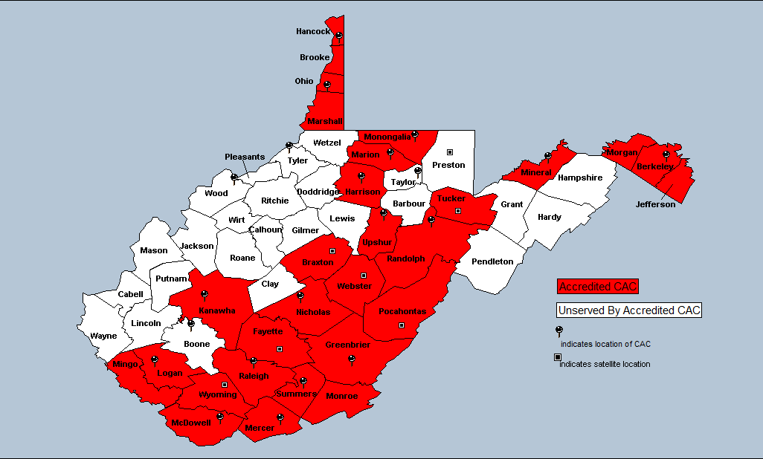
2013
17 accredited CACs; 29 counties

Slide 20
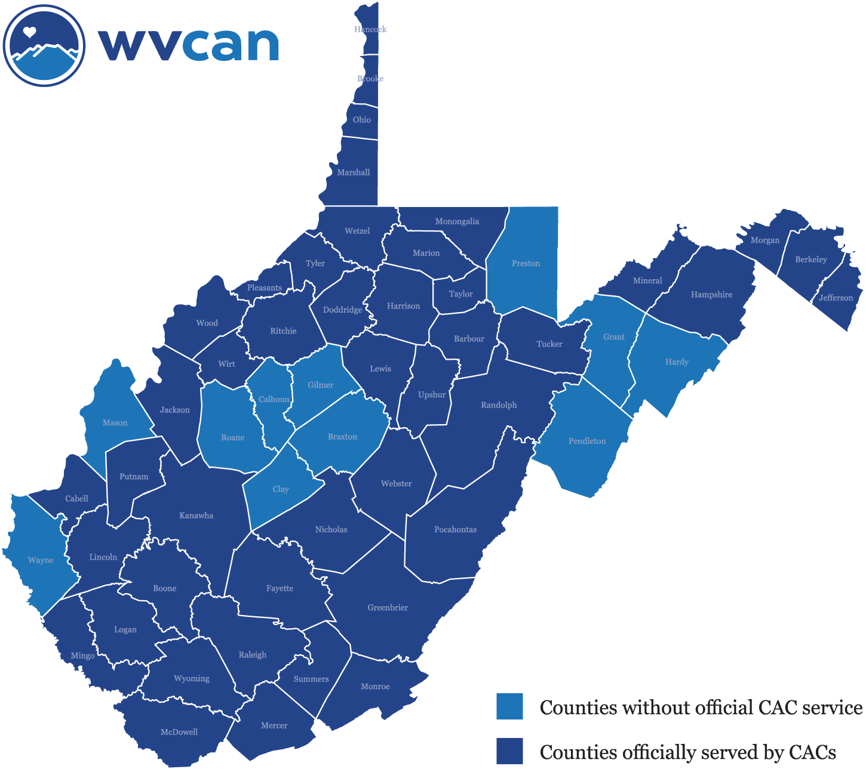
Current Growth/Expansion Efforts
44 counties officially served by 21 CACs; growth plan to serve rest of state in next 6 years

Slide 21
Children Served

Slide 22
Outcomes
Every single study on the effectiveness of CACs has positively supported the model
What we know:
  The child’s experience
    Consistent and fast follow-up to abuse reports
    Effective medical and mental health services
    Continuity between investigative and treatment processes
  The non-offending caregiver’s experience
  Each discipline’s experience
  The community’s experience
Notes:
Grace

Slide 23
Benefits of a Coordinated Response
CAC communities demonstrated¹:
  Significantly higher rates of coordinated investigations between law enforcement and CPS
  Team forensic interviews
  Case Review
  Recording of forensic interview
  Interviews in child-friendly settings

Slide 24
Client Satisfaction
Caregivers whose children were seen at the CAC²:
  Higher rates of satisfaction than caregivers whose children were seen at the comparison sites
  Significantly more satisfied with the interview experience than caregivers from the comparison samples
  Children who were seen at the CAC:
    Significantly more described themselves as being “not at all” or “not very” scared versus kids from the comparison communities

Slide 25
Access to Medical Care
Children served at CAC were much more likely to receive forensic medical exam³:
  No penetration in abuse disclosure - 4 times more likely
  Penetration in abuse disclosure - 1.5 times more likely

Slide 26
Case Processing Time
Charging decision in child sexual abuse cases⁴:
  Cases seen at the CAC had a significantly faster charging decision:
    CAC Communities Studied – 80% within 1-60 days
    Comparison Community Group A – 49% within 1-60 days
    Comparison Community Group B – 58% within 1-60 days

Slide 27
Cost-Benefit Analysis
Traditional investigations were 36% more expensive than CAC investigations.⁶
The average per-case cost:
  CAC investigation - $2,902
  Non-CAC investigation - $3,949

Slide 28
Other MDT Partner Benefits
Cases less likely to fall through the cracks.
Provides avenues for investigators to gain more information about a case.
Provides opportunities to coordinate investigative duties reducing the chance of one agency inadvertently impeding the investigation for another agency.
MDT can provide the opportunity for professionals to find support for the difficult aspects of these cases.

Slide 29
Current Status of CACs in WV
21 CACs
Structure of organizations
  Independent nonprofit
  Umbrellaed organizations
  Hospital-based
Budgets
Board structures
Scope of activity and staffing structures

Slide 30
Current Trends
County expansions
Deepening of services
  Mental Health – On-site/In-school
  Victim Advocacy
  Medical
Updating practice to meet emerging needs
  YPSB

Slide 31
From the field
“…These kids work so well with these advocates. They open up, they talk to these advocates, so by the time an arrest has been made and I get involved with the children and go to court, we work hand in hand. I don’t know what I’d do without them. ”
- Jeannie Christian, Advocate, Logan County Prosecutor’s Office

Slide 32
From the field
“…We have different expertise but I think that fewer clients fall through the cracks because [of the advocates] that are a part of our team that communicate and work together to make sure that doesn’t happen.”
- Renee Yokum, Advocate, Women’s Aid in Crisis, Elkins

Slide 33
Who is WVCAN?
State alliance of Child Advocacy Centers
Provide support, guidance, assistance to CACs in all stages of development
Membership Benefits
  Community Awareness and Advocacy
  Training & Technical Assistance
  Evaluation and Assessment
  Funding

Slide 34
References
Cross, T.P., Jones, L.M., Walsh, W.A., Simone, M., & Kolko, D.J. (2007). Child forensic interviewing in children’s advocacy centers: Empirical data on a practice model. Child Abuse and Neglect, 31, 1031-1052.
Jones, L.M., Cross, T.E., Walsh, W.A., & Simone, M. (2007). Do children’s advocacy centers improve families’ experiences of child sexual abuse investigations? Child Abuse and Neglect, 31, 1069-1085.
Walsh, W.A., Lippert, T., Cross, T.E., Maurice, D.M., & Davison, K.S. (2008). Which sexual abuse victims receive a forensic medical examination? The impact of Children’s Advocacy Centers. Child Abuse and Neglect, 31, 1053-1068.
Walsh, W.A., Lippert, T., Cross, T.E., Maurice, D.M., & Davison, K.S. (2008). How long to prosecute child sexual abuse for a community using a children’s advocacy center and two comparison communities? Child Maltreatment, 13(1), 3-13.
Miller, A. & Rubin, D. (2009). The contribution of children’s advocacy centers to felony prosecutions of child sexual abuse. Child Abuse and Neglect, 33, 12-18.
Formby, J., Shadoin, A. L., Shao, L, Magnuson, S. N., & Overman, L. B. (2006). Cost-benefit analysis of community responses to child maltreatment: A comparison of communities with and without child advocacy centers. (Research Report No. 06-3). Huntsville, AL: National Children's Advocacy Center.

Slide 35
Wvcan.org
304.414.4455
info@wvcan.org

