Slide 1

The State We’re In
CAC logo goes here
A look at 2022 child abuse statistics
in ___ and ___ Counties

Slide 2


What Is a Child Advocacy Center?
A child advocacy center (CAC) is a safe, child-friendly facility where child protection, criminal justice, and child treatment professionals work together to investigate abuse, hold offenders accountable, and help children heal. In the darkest moments, a CAC creates a safe environment for children to tell their story and begin their path to healing.

Slide 3

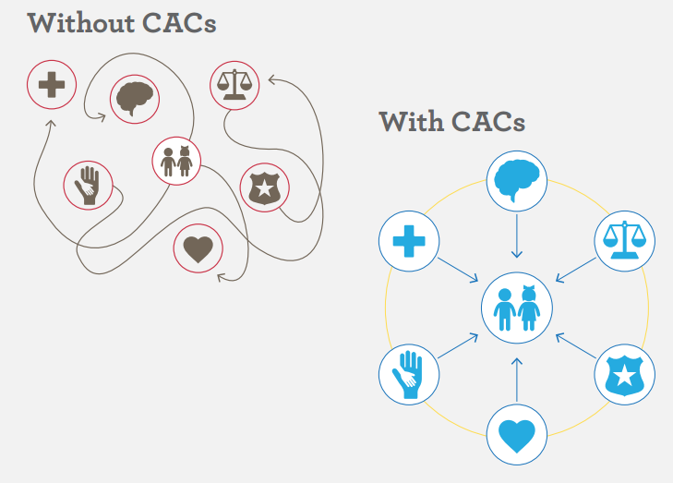

Rather than having a child taken from agency to agency to endure multiple interviews, the CAC model coordinates the response around the child for an effective, child-centered, healing process.

Slide 4

Our CAC served ___ children last year
__% more than 5 years ago
sex: __% male | __% female
age: __% 0-6 years | __% 7-12 years | __% 13-18+
race/ethnicity: __% white | __% black | __% Hispanic
disability: __% reported or suspected
CAC logo goes here

Slide 5

Those alleged to have
perpetrated abuse
AGE OF ABUSER
__% 18+
_% 13-17
_% under 13
_% unknown
RELATIONSHIP TO CHILD
__% parent
__% step-parent
__% other relative
__% parent's boyfriend/girlfriend
__% other known person
_% unidentified
_% stranger
CAC logo goes here

Slide 6

Types of abuse
Sexual abuse: [number of cases here for each]
Physical abuse: __
Drug endangerment: __
Neglect: __
Witness to violence: __
Exposure to pornography: __
Depiction in pornography: __
CAC logo goes here

Slide 7

Signs of Abuse
UNEXPLAINED INJURIES: Unexplained burns or bruises in the shape of objects. You may also hear unconvincing explanations of a child’s injuries.
CHANGES IN BEHAVIOR: Abused children often appear scared, anxious, depressed, withdrawn or more aggressive.
REGRESSING: I.e. thumb-sucking, bed-wetting, fear of the dark or strangers. For some, even loss of acquired language or memory problems may be an issue.
FEAR OF GOING HOME: Apprehension or anxiety about leaving school or about going places with the person who is abusing them.
CAC logo goes here

Slide 8

Signs of Abuse
CHANGES IN EATING: The stress, fear and anxiety caused by abuse can lead to changes in a child’s eating behaviors, which may result in weight gain or weight loss.
CHANGES IN SLEEPING: Abused children may have frequent nightmares or have difficulty falling asleep, and as a result may appear tired or fatigued.
CHANGES IN SCHOOL PERFORMANCE: Abused children may have difficulty concentrating in school or have excessive absences.
CAC logo goes here

Slide 9
Signs of Abuse
POOR HYGIENE: Abused and neglected children may be consistently dirty and have severe body odor, or they may lack sufficient clothing for the weather.
RISK TAKING: Young people who are being abused may engage in high-risk activities such as using drugs or alcohol or carrying a weapon.
INAPPROPRIATE SEXUAL BEHAVIORS: Children who have been sexually abused may exhibit overly sexualized behavior or use explicit sexual language.
CAC logo goes here

Slide 10

If a child discloses
DO
Remain calm.
Believe the child.
Allow the child to talk.
Show interest and concern.
Reassure and support the child.
Take action. It could save a child’s life.
Report within 24 hours, as mandated by WV law.
DON’T
Panic or overreact.
Press the child to talk.
Promise anything you can’t control.
Confront the offender.
Blame or minimize the child’s feelings.
Overwhelm the child with questions.
CAC logo goes here

Slide 11

Reasons to believe
IT HAPPENS MORE THAN YOU THINK: One in every 100 WV children walk through the doors of a Child Advocacy Center every year following an allegation of serious physical or sexual abuse or neglect. More than 4,000 WV kids a year are seen at a CAC due to an allegation of abuse.
KIDS HAVE A GOOD REASON TO STAY QUIET: More than 90% of the time, children know their abusers. Most often the only witnesses are the child and the abuser.
FALSE REPORTS ARE UNCOMMON: Only 2-5% of reports of child sexual abuse are fabricated.
YOUR RESPONSE MATTERS: Adult survivors of abuse often say being listened to and believed was an important part of their healing.
CAC logo goes here

Slide 12
How to Report
Immediately, and not more than 24 hours after, report the circumstances to WV DHHR 24/7 Child Abuse & Neglect Hotline: (800) 352-6513
For serious physical abuse and sexual abuse, also contact the state police and local law enforcement. WV Crimes Against Children Unit: (304) 293-6400
CAC logo goes here

Slide 13

You have the power to stop abuse!
Website goes here
Email goes here
Phone number goes here
CAC logo goes here

